Slide 1
Online Roller Production & Selling Management
Roll Number | Division | Full Name
39 | A | Patil Pavan Ananda
60 | A | Vaghela Sahil Sandipbhai

Slide 2
Project Definition: Online Roller Production & Selling Management.
Project Description:
In online roller production & selling we manage
Manufacturing of ebonite & rubber roller, hard Crome roller,
Aluminum roller and selling online. customer can easily order
The roll by his requirement.
In our web application customer can easily manage
Own profile and admin manage product and job work charges.
And supplier and raw material will manage by the admin.
Admin manage actual work and generate bill as per order.

Slide 3
Company Description:
→Our Company Name is Mahakali Engineering Works.
→It is Manufacturing Ebonite & Rubber Roller, Hard Crome
Roller, Aluminum Roller. That all type of rollers uses in
industries for Plastic Machine, aglo machine for plastic.
Customer order the Roller As Per his requirement.
→Address: 186, Vijay industrial Estet B/H Bhikshukgruh
Central Workshop Road, Odhav, Ahmedabad,
Gujrat.
→ Owner Detail & Contact No.: - Lalit Santosh Patil.
Mobile No.: - 7433091598

Slide 4
Tools & Technology:
○ Front End: - Python 3.10, Django
○ Back End: - MySQL 8.0
○ Server: - XAMPP 8.16
○ Editor: - VS Code 1.69
○ Other Tools: -
→MS Visio 2007 (For Diagram)
→MS Word 2016 (For Documentation)
→MS PowerPoint 2016 (For Presentation)

Slide 5
○ Existing System: -
• In Current System, order is done by telephone and face to face
Conversation.
• In Current system, the cost of roller is discussed over the phone,
So it is time consuming process.
• In Current System, if the customer wants any information About
Rollers so it will call. But the problem is that it not Possible for
manager to give answer of all customer.
• In current System, all rollers bill is done by the manger using bill
Book.
• Currently no structured stock management facility is available
with company.

Slide 6
○ Proposed System: -
• The proposed system is web-based application and it
Maintains activities of roller production & selling
Management.
• In the proposed system, the customer can get the price
Of the roller with help of a cost calculator.
• In the proposed system, customer can get information
Of roller in our web application.
• The system manages all the bill and payment of the
Customer easily.
• Inventory will be managed easily by system.

Slide 7
List Of Modules: -
Customer Management
Product Management
Inventory Management
Employee Management
Order Management
Billing and payment Management

Slide 8
Brief Description of Each Module: -
1.Customer Management: -
In customer management modules
Customer Register with the system. Customer can manage
own Company Profile And Login Detail.
Admin can view and manage company/customer details.

Slide 9
2.Product Management: -
In this module we will provide facilities to
admin to manage different products & charges for ready product
And job work.
Different type of rollers like ebonite & rubber roller hard
Crome roller Aluminum roller is manufactured or job worked
By Company. Charges of different rollers are based on type, length
Diameter etc.
Charges for that will be managed by admin.

Slide 10
3.Inventory Management: -
Admin will manage supplier & raw material.
Admin will manage purchase of raw material as per requirement
Like MS, SS, Aluminum, Crome.
Admin will manage use of raw material in different product.
Sell order will be done by customers.
Admin will Manage the sell and production of roller.
Admin will manage the purchase of raw material as per
The Requirement of the rollers production and sell order.
Stock of raw material & product will be managed by the
System as per transactions.

Slide 11

4.Employee Management:-
Admin Will give the production work or job work to the employee .As per the customer placed order.
And then after the production work or job work order is done .The employee will hand over the complete work to the admin.

Slide 12
5.Order Management: -
Admin will manage charge for production & job
work of different products.
At the time of placing order, as per customer requirement
cost of the order will be calculated as per length, diameter,
Material by System.
Admin will Manage the Job work and Product Work.
Customer can place order. Admin will manage order.

Slide 13
6.Billing and Payment Management: -
Admin will generate bill as per
order and actual work done which will be received by customer.
Admin will manage payment of customer.

Slide 14
Unified Modeling Language
- Use Case Diagram

Slide 15
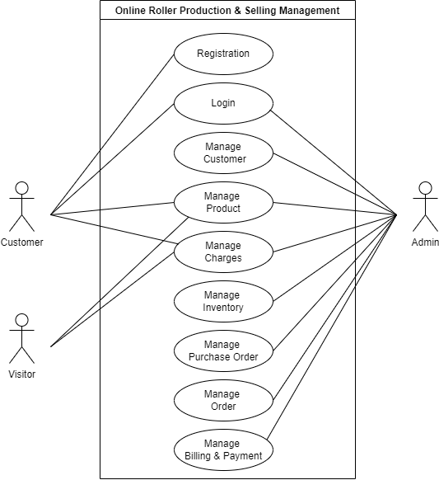

Slide 16
Sequence Diagram:-

Slide 17
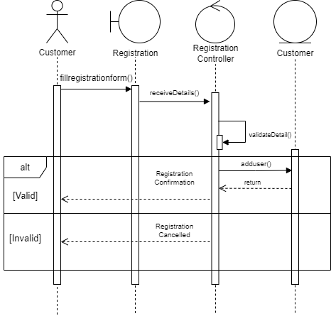
Registration:-

Slide 18
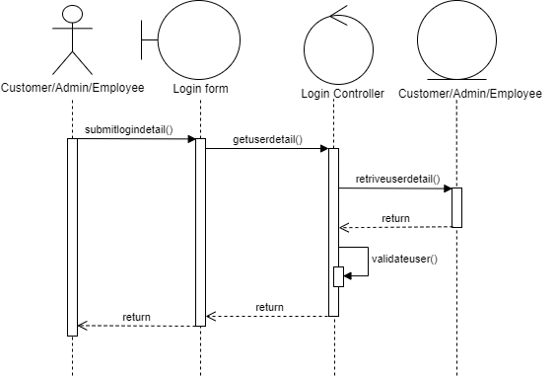
Login:-

Slide 19
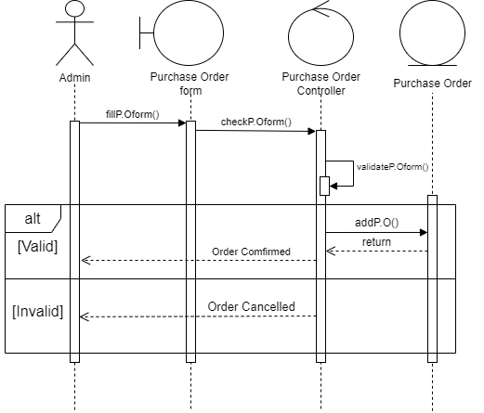
Purchase Order:-

Slide 20
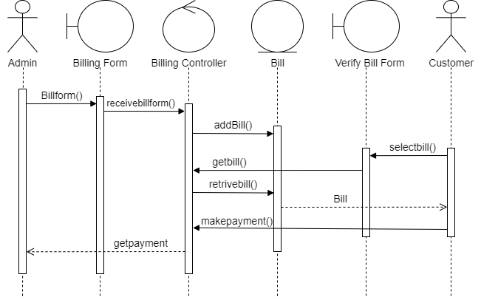
Billing & Payment :-

Slide 21
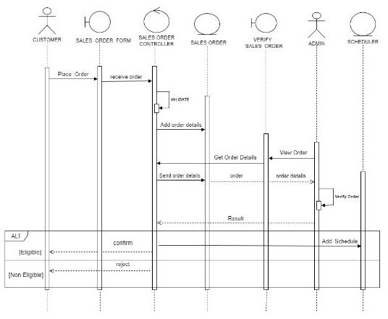
Sales Order:-

Slide 22
Activity Diagram:-

Slide 23
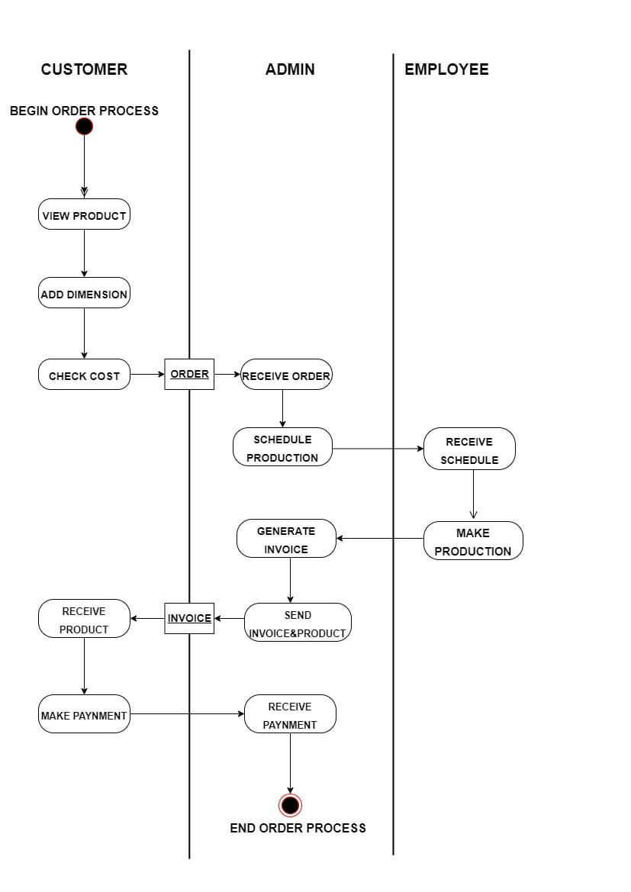
Order Activity Diagram:-

Slide 24
State Chart Diagram:-

Slide 25
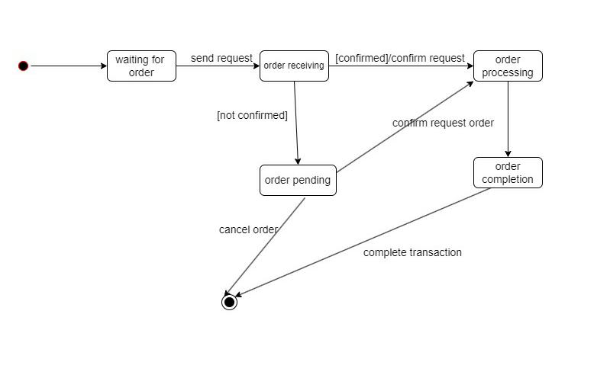
Order State Chart Diagram:-

Slide 26
Class Diagram: -

Slide 27
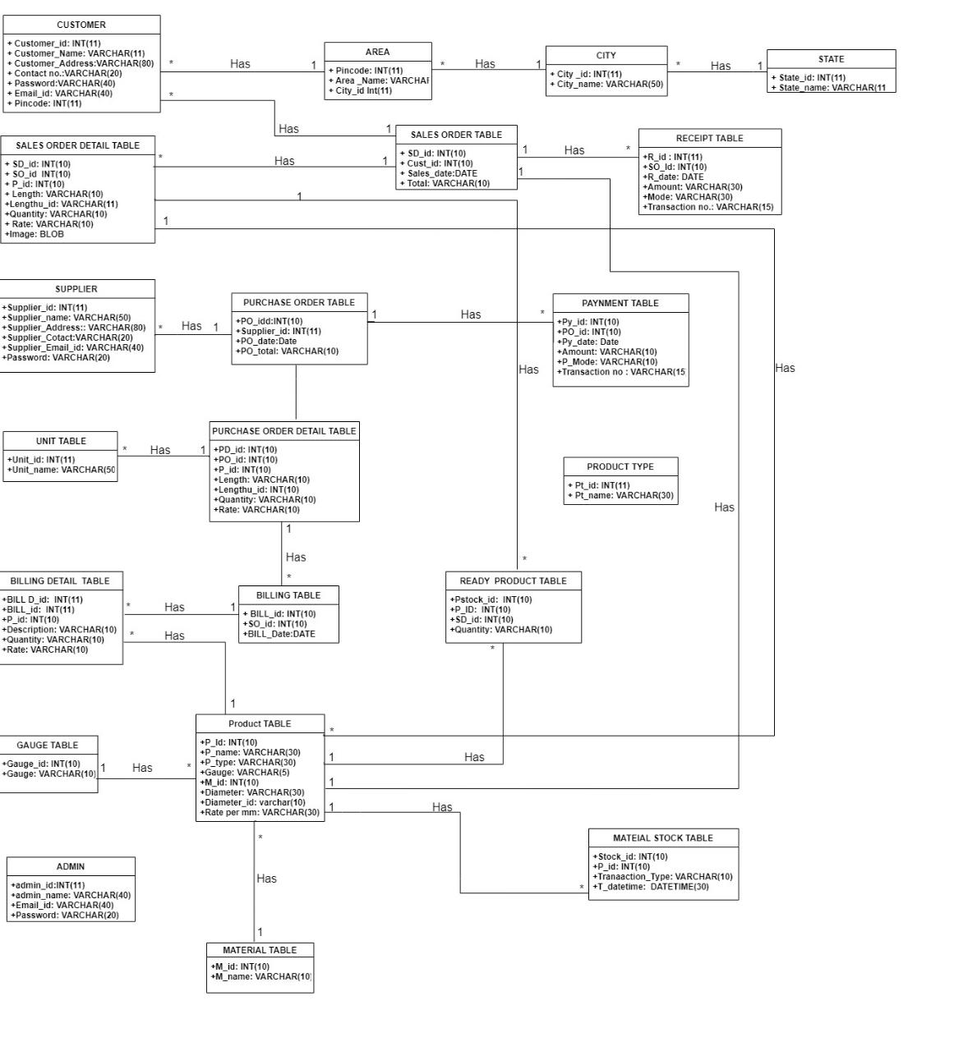

Slide 28
Data Dictionary:-

Slide 29
State Table With Example:-
1.State Table: -
Primary Key: - State_id
Description: - It Stores state Detail
Fieldname | Datatype | Size | Constraint | Description
State_id | Int | 11 | P.K | Store State id
State_name | varchar | 50 | Not Null | Store State Name
State_id | State_name
1 | Gujrat
2 | Maharashtra
3 | Rajasthan
4 | Madhya Pradesh

Slide 30
City Table With Example:-
2.City Table: -
Primary Key: - City_id
Foreign Key: - State_id
Description: - It Stores City Detail
Fieldname | Datatype | Size | Constraint | Description
City_id | Int | 11 | P.K | Store City id
City_name | varchar | 50 | Not Null | Store City name
State_id | Int | 11 | F.K | Store State id
City_id | City_name | State_id
1 | Ahmedabad | 1
2 | Mumbai | 2
3 | Jaisalmer | 3
4 | Bhopal | 4

Slide 31
Area Table With Example:-
3.Area Tabel: -
Primary Key: - Pin code
Foreign Key: - City_id
Description: - It Stores Area Detail
Fieldname | Datatype | Size | Constraint | Description
Pincode | Int | 11 | P.K | Store Pin code
Area_name | varchar | 50 | Not Null | Store Area Name
City_id | Int | 11 | F.K | Store State id
Pin code | Area_name | City_id
382415 | Odhav | 1
400092 | Borivali West | 2
345023 | Ajasar | 3
462021 | Anand Nagar | 4

Slide 32
Customer Table:-
4.Customer Table: -
Primary Key: - Customer_id
Foreign Key: - Pin code
Description: - It Stores Customer Details
Fieldname | Datatype | Size | Constraint | Description
Customer_id | Int | 11 | P.K | Store Customer Id
Customer_name | varchar | 40 | Not Null | Store Customer Name
Customer_address | varchar | 80 | Not Null | Store Customer Address
Contact no. | varchar | 30 | Not Null | Store Customer Contact No.
Password | varchar | 20 | Not Null | Store Customer Password
Email_id | varchar | 40 | Not Null | Store Customer Email id
Pincode | Int | 11 | F.K | Store Customer Pin code

Slide 33
Customer Example:-
Customer_id | Customer_name | Customer_address | Contact no. | Password | Email_id | Pin code
1. | Suresh | Ahmedabad | 9924565266 | ******** | hjus5@gmail.com | 382415
2. | Mukesh | Vadodara | 8746252255 | ******** | jsiaj3@gmail.com | 390002
3. | Rajesh | Anand | 5442115451 | ******** | abcd1@gmail.com | 398210
4. | Mahesh | Rajkot | 5541575518 | ******** | ab45@gmail.com | 398312

Slide 34
Admin Table With Example:-
5.Admin Table: -
Primary Key: - Admin_id
Description: - It Stores Admin`s Details
Fieldname | Datatype | Size | Constraint | Description
Admin_id | Int | 11 | P.K | Store Admin id
Admin_name | varchar | 40 | Not Null | Store Admin Name
Email_id | varchar | 40 | Not Null | Store Admin Email id
Password | varchar | 20 | Not Null | Store Admin Password
Admin_id | Admin_name | Email_id | Password
1 | Lalit | ad44@gmail.com | ********

Slide 35
Supplier Table With Example:-
6.Supplier Table: -
Primary Key: - Supplier_id
Description: - It Stores Supplier Details
Fieldname | Datatype | Size | Constraint | Description
Supplier _ id | Int | 20 | P.K | Store Supplier id
Supplier _ name | varchar | 50 | Not Null | Store Supplier name
Supplier_address | varchar | 80 | Not Null | Store Supplier Address
Supplier_contact | varchar | 20 | Not Null | Store Supplier Contact
Supplier_email id | varchar | 40 | Not Null | Store Supplier Email id
Supplier_id | Supplier_name | Supplier_address | Supplier_contact | Supplier_email id
1 | Ashok | Ahmedabad | 8188465694 | ask94@gmail.com
2 | Ranjit | Anand | 4545552945 | an45@gmail.com
3 | Ramesh | Rajkot | 4854888715 | sh15@gmail.com

Slide 36
Material Table With Example :-
7.Material Table: -
Primary Key: - M_id
Description: - It Stores Material Detail
Fieldname | Datatype | Size | Constraint | Description
M_id | Int | 11 | P.K | Store Material_id
Material_name | Varchar | 40 | Not Null | Store Material name
M_id | Material_name
1 | Ebonite
2 | Rubber
3 | Aluminium
4 | Hard Crome

Slide 37
Product Type Table With Example:-
8.Product Type Table: -
Primary Key: - Pt_id
Description: - It Stores Product Type Detail
Fieldname | Datatype | Size | Constraint | Description
Pt_id | int | 11 | P.K | Store Product Type id
Pt_name | varchar | 30 | Not Null | Store Product Name
Pt_id | Pt_name
1 | Ebonite Rod
2 | Rubber Pipe

Slide 38
Unit Table Example:-
9.UnitTable: -
Primary Key: - Unit_id
Description: - It Stores Unit Details
Fieldname | Datatype | Size | Constraint | Description
Unit_id | int | 11 | P.K | Store Unit Id
Unit_name | varchar | 30 | Not null | Store unit name
U_id | U_name
1 | mm
2 | inch
3 | feet

Slide 39
Product :-
10.Product Table: -
Primary key: - P_id(Product Id)
Foreign Key: - Gauge U_id(Gauge Unit Id), M_id(Material Id), Diameter U_id(Diameter Unit Id)
Description: - It Stores Product Details
Fieldname | Datatype | Size | Constraint | Description
P_id | int | 11 | P.K | Store product id
P_name | varchar | 30 | Not Null | Store product name
P_type | varchar | 30 | Not Null | Store product type
Gauge | varchar | 5 |  | Store gage
Gauge U_id | int | 11 | F.K | Store gage unit id
M_id | int | 11 | F.K | Store Material id
Diameter | varchar | 30 | Not Null | Store Diameter
Diameter U_id | int | 5 | F.K | Store Diameter Unit id
Rate Per mm | varchar | 30 | Not Null | Store Rate Per mm
P_image | varchar | 100 |  | Store Product Image
P_Description | Varchar | 100 | Not Null | Store Product Description

Slide 40
Product Example:-
P_id | P_name | P_type | Gauge | Gauge U_id | M_id | Diameter | Diameter U_id | Rate Per mm | P_image | P_Description
1 | Ebonite Rode | Rod | - | - | 1 | 21 | 2 | 50 | ebonite.png | Ebonite Roller is light Weight
2 | Rubber Pipe | Pipe | 20 | 1 | 2 | 22 | 2 | 30 | rubber.png | Rubber Roller is Round Shaft Or Tube
3 | Aluminium Rod | Rod | - | - | 3 | 23 | 2 | 70 | aluminium.jpeg | Aluminium Roller is Highly Durable
4 | Hard Crome Pipe | Pipe | 25 | 1 | 4 | 24 | 2 | 35 | cromr.jpeg | Hard Crome Roller is Manufacturer With Finest Quality

Slide 41
Material Stock Table With Example: -
11. Material Stock Table with Example: -
Primary Key: - Stock_id
Foreign Key: - P_id(Product_id)
Description: - It Stores Material Stock Detail
Fieldname | Datatype | Size | Constraint | Description
Stock_id | int | 11 | P.K | Store Stock id
P_id | int | 11 | F.K | Store Product id
Transaction_type | varchar | 10 | Not null | Store Transaction type
Transaction_datetime | date | 6 | Not null | Store Transaction date & time
Stock_id | P_id | Transaction_type | Transaction_datetime
1 | 2 | Purchase | 05/09/2022,10:23:55
2 | 1 | use | 07/09/2022,09:30:22

Slide 42
Ready Product Table With Example: -
12. Ready Product Table with Example: -
Primary Key: - Pstock_id(Product Stock Id)
Foreign Key: - P_id(Product Id)
Description: - It Stores Ready Product Detail
Fieldname | Datatype | Size | Constraint | Description
Pstock_id | int | 11 | P.K | Store Product Stock id
P_id | int | 11 | F.K | Store Product id
Sd_id | int | 11 | F.K | Store Sales Order Detail id
Quantity | varchar | 30 | Not null | Store Quantity
Pstock_id | P_id | Sd_id | Quantity
1 | 2 | 2 | 10
2 | 1 | 2 | 15

Slide 43
Employee Table With Example:-
13.Employee Table: -
Primary Key: - E_id(Employee Id)
Description: - It Stores Employee Detail
Fieldname | Datatype | Size | Constraint | Description
E_id | int | 11 | P.K | Store Employee id
E_name | varchar | 20 | Not null | Store Employee name
J_date | Date | 10 | Null | Store Join Date Of Employee
E_Email id | varchar | 50 | Not null | Store Employee Email id
E_contact | varchar | 10 | Not null | Store Employee Contact no
E_Address | varchar | 100 | Not null | Store Employee Address
E_city | varchar | 20 | Not null | Store Employee City
E_id | E_name | J_date | E_Email id | E_contact | E_Address | E_city
1 | Rohit | 04/01/2022 | Rohit78912@gmail.com | 9152578892 | Maninagar | Ahmedabad
2 | Mahesh | 06/02/2022 | Mahesh78@gmail.com | 8819283789 | Odhav | Ahmedabad
3 | Suresh | 10/07/2022 | Suresh912@gmail.com | 9818282568 | Vatva | Ahmedabad

Slide 44
Purchase Order Table With Example:-
14.Purchase Order Table: -
Primary Key: - Po_id(Purchase Order Id)
Foreign Key: - Supplier_id
Description: - It Stores Purchase Order Details
Fieldname | Datatype | Size | Constraint | Description
Po_id | int | 11 | P.K | Store Purchase order id
Supplier_id | int | 15 | F.K | Store Supplier id
Po_date | date | 10 | Not null | Store Purchase order date
Po_total | varchar | 30 | Not null | Store purchase order total
Po_id | Supplier_id | Po_date | P_total
1 | 1 | 11/10/2022 | 11,625

Slide 45
Purchase Order Detail Table With Example:-
15.Purchase Order Detail Table: -
Primary Key: - Pd_id(Purchase Order Detail Id)
Foreign Key: - Po_id(Purchase Order Id), P_id(Product Id), Length U_id(Length Unit Id)
Description: - It Stores Purchase Order Detail Tables`s Detail
Fieldname | Datatype | Size | Constraint | Description
Pd_id | int | 11 | P.K | Store Purchase Order Detail id
Po_id | int | 11 | F.K | Store Purchase Order id
P_id | int | 11 | F.K | Store product id
length | varchar | 10 | Not null | Store length
Length U_id | int | 10 | F.K | Store length Unit id
Quantity | varchar | 10 | Not null | Store quantity
Rate | varchar | 10 | Not null | Store rate
Pd_id | Po_id | P_id | Length | Length U_id | Quantity | Rate
1 | 1 | 1 | 16.7 | 3 | 10 | 5000
2 | 1 | 3 | 17 | 3 | 15 | 6000
3 | 1 | 4 | 18 | 3 | 20 | 7000

Slide 46
Sales Order Table With Example:-
16.Sales Order Table: -
Primary Key: - So_id(Sales Order Id)
Description: - It Stores Sales Order Detail
Fieldname | Datatype | Size | Constraint | Description
So_id | int | 11 | P.K | Store Sales id
Cust_id | int | 11 | F.K | Store Customer id
Sales_date | date | 10 | Not null | Store Sales date
Total | Varchar | 10 | Not null | Store total
Sales_id | Cust_id | Sales_date | Total
2 | 2 | 11/10/2022 | 15,500

Slide 47
Sales Order Detail Table With Example:-
17.Sales Order Detail Table: -
Primary Key: - Sd_id(Sales Order Detail Id)
Foreign Key: - So_id(Sales Order Id), P_id(Product Id), Length U_id(Length Unit Id)
Description: - It Stores Sales Order Detail Table`s Detail
Fieldname | Datatype | Size | Constraint | Description
Sd_id | int | 11 | P.K | Store Sales Detail id
So_id | int | 11 | F.K | Store sales id
P_id | int | 11 | F.K | Store product id
Length | varchar | 10 | Not null | Store length
Length U_id | int | 10 | F.K | Store length unit id
Quantity | varchar | 10 | Not null | Store quantity
Rate | varchar | 10 | Not null | Store rate
Image | varchar | 100 |  | Store image
Sd_id | S_id | P_id | length | Length U_id | Quantity | Rate | Image
1 | 2 | 2 | 13.5 | 3 | 15 | 5200 | rubber.jpeg
2 | 2 | 3 | 15 | 3 | 20 | 5300 | aluminium.png
3 | 2 | 4 | 16 | 3 | 25 | 5000 | crome.jpeg

Slide 48
Billing Table With Example:-
18.Billing Table: -
Primary Key: - Bill_id
Foreign Key: - So_id(Sales Order Id)
Description: - It Stores Billing Detail
Fieldname | Datatype | Size | Constraint | Description
Bill_id | int | 11 | P.K | Store Bill id
So_id | varchar | 10 | F.K | Store sales id
Bill_date | date | 10 | Not null | Store bill date
Total | varchar | 10 | Not Null | Store total
Bill_id | S_id | Bill_date | Total
2 | 2 | 11/10/2022 | 15,500

Slide 49
Billing Detail Table With Example:-
19.Billing Detail table: -
Primary Key: - Bd_id(Bill Detail Id)
Foreign key: - Bill_id, P_id(Product Id)
Description: - It Stores Billing Detail Table`s Detail
Fieldname | Datatype | Size | Constraint | Description
Bd_id | int | 11 | P.K | Store bill detail id
Bill_id | int | 11 | F.K | Store bill id
P_id | int | 11 | F.K | Store product id
Description | varchar | 60 | Not null | Store description
Quantity | varchar | 10 | Not null | Store Quantity
Rate | varchar | 10 | Not null | Store Rate
Bd_id | Bill_id | P_id | Description | Quantity | Rate
1 | 2 | 2 | It Is Rubber Pipe Roller | 15 | 100
2 | 2 | 3 | It Is Aluminium Rod | 20 | 150
3 | 2 | 4 | It Is Hard Crome Pipe Roller | 25 | 200

Slide 50
Payment Table With Example:-
20.Payment Table: -
Primary Key: - Py_id(Payment Id)
Foreign Key: - Po_id(Purchase Order Id)
Description: - It Stores Payment Detail
Fieldname | Datatype | Size | Constraint | Description
Py_id | int | 11 | P.K | Store Payment id
Po_id | int | 11 | F.K | Store purchase order id
Py_date | date | 10 | Not null | Store payment date
Amount | varchar | 10 | Not null | Store Amount
Mode | varchar | 10 | Not null | Store Mode
Transaction No | varchar | 15 | Not Null | Store Transaction No
Py_id | Po_id | Py_date | Amount | Mode | Transaction No
1 | 1 | 10/11/2022 | 16,000 | Cash | -
2 | 2 | 15/11/2022 | 17,500 | UPI | UB0225356736
3 | 3 | 17/11/2022 | 18,000 | UPI | UD0226918786

Slide 51
Receipt Table With Example:-
21.Receipt Table: -
Primary Key: - R_id(Receipt Id)
Foreign Key: - So_id(Sales Order Id)
Description: - It Stores Receipt Detail
Fieldname | Datatype | Size | Constraint | Description
R_id | int | 11 | P.K | Store receipt id
So_id | int | 11 | F.K | Store sales order id
R_date | date | 10 | Not null | Store receipt date
Amount | varchar | 10 | Not null | Store amount
Mode | varchar | 30 | Not null | Store mode
Transaction No | varchar | 15 | Not null | Store Transaction no
R_id | So_id | R_date | Amount | Mode | Transaction No
1 | 2 | 15/11/2022 | 10,000 | Cash
2 | 3 | 18/11/2022 | 5000 | Cheque | IDRB8682
3 | 4 | 20/11/2022 | 7000 | UPI | BD2253355659

